Slide 1




Slide 2
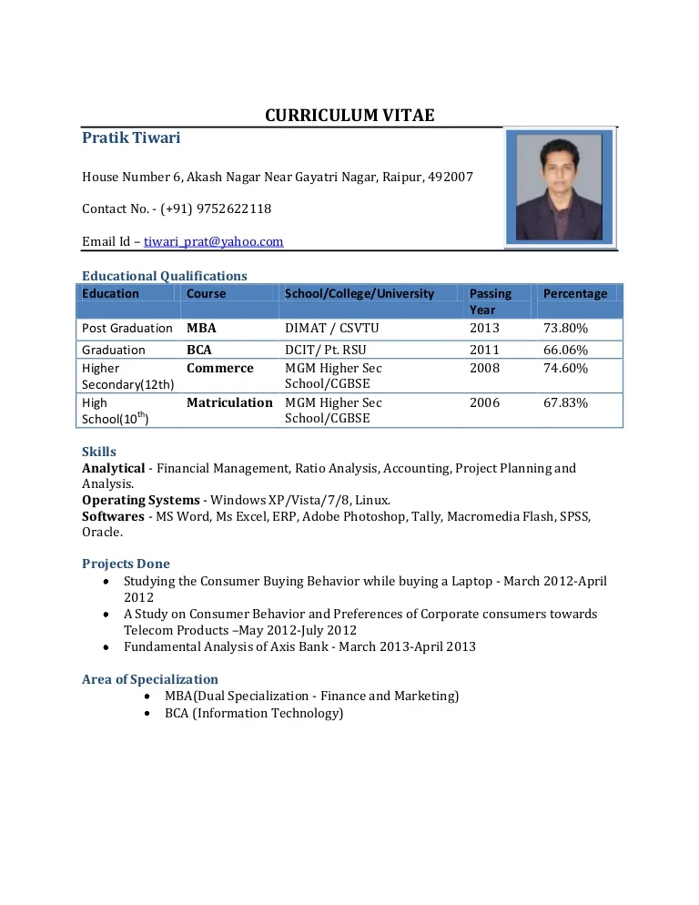
CV (Curriculum Vitae)
Person’s education, qualifications, and previous experience
First things employers look at when they want to hire people.

Slide 3
Similarity of CV and Resume
Are tailored for the specific profile/organization applying for
Represent you as the best-qualified candidate
Are used to get you an interview
Do not usually include personal interests

Slide 4
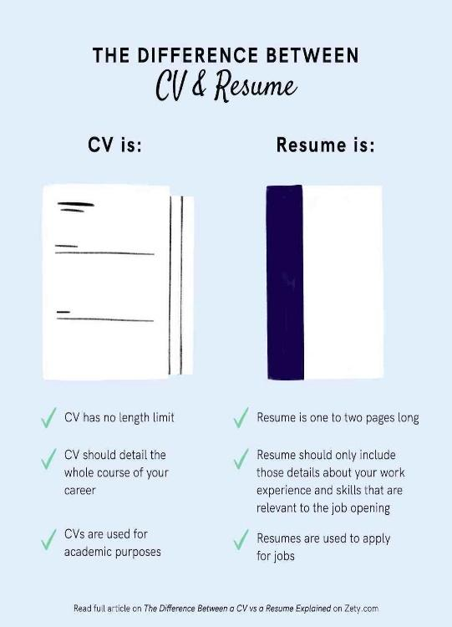
Difference between resume and CV

Slide 5

Video CV
A video continue is a brief video to acquaint yourself with the hiring manager or recruiter. It is much of the time submitted notwithstanding a resume and introductory letter.

Slide 6
BASIC ELEMENTS
Between 30 seconds to two minutes in length
Name
The background of education
Strengths
Achievements
Mission
Current position, and so more

Slide 7
IMPORTANCE
Indicates the applicant’s creativity
Show technical skills related to the job position
Nonverbal communication
Para verbal communication
Verbal communication

Slide 8
CONTENT
Video so that it has a beginning, middle, and end.
Beginning
Introduction
Purpose of creating video
Right person or a job
Middle
Unique selling point
Relevant skill
Experience
End
Summarize
Right for role
Call to action

Slide 9


TECHNICAL ASPECT (requirements)
Computer, internet access, and a camera as a minimum
Make sure that the audio quality is good
When filming, make the video dynamic by using shots and
camera angles

Slide 10

FINAL TIPS
Dress code has to be professional
Look for a good background
Preparation of a script
Knowing about your audience
Ilustrate what are you saying
Keep it brief
Look for feedback

Slide 11
EXAMPLES
https://www.youtube.com/watch?v=J4xoxOySVp4&t=90s https://www.youtube.com/watch?v=v2eX1vTDyJg https://www.youtube.com/watch?v=hCwSDBbeO_g
https://www.youtube.com/watch?v=PZpeDuVBu08

Slide 12


Slide 13


